Slide 1

Forecasting Solar Energy Consumption in the United States
Justin Vernieri

Slide 2
The Problem
Solar is one of the fastest-growing renewable energy sources in the U.S.
Personal interest: driven by the shift toward sustainable energy in business practices
Goal: forecast monthly solar energy consumption over next two years
Importance:
Helps policymakers, utility companies, and investors plan for renewable energy integration
Supports energy grid planning, energy pricing, and policy decisions
Helps meet climate goals and ensure energy security

Slide 3
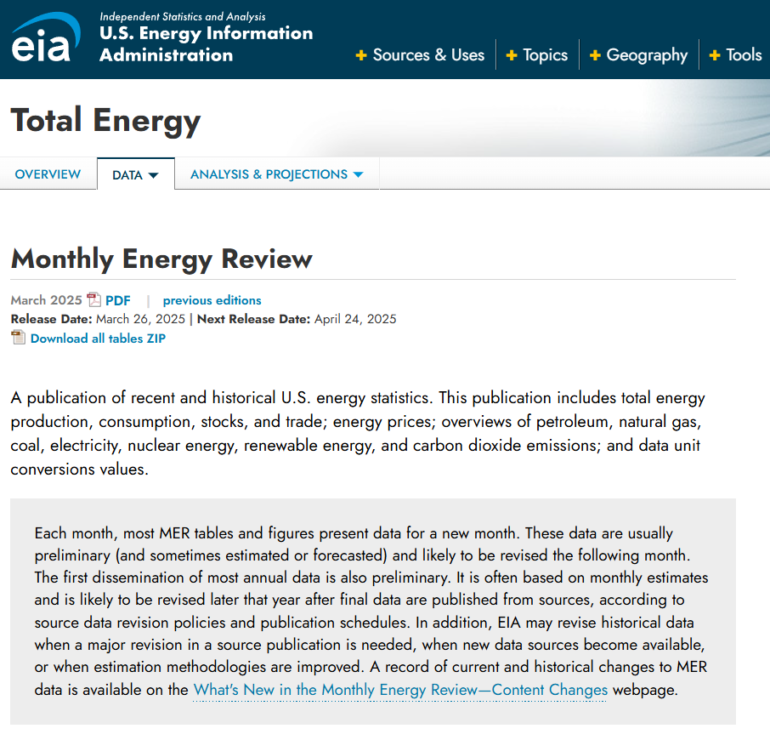
The Data
Source: U.S. Energy Information Administration (EIA) – reliable, government-backed, updated frequently
Timeframe: Monthly data from Jan 1984 to Dec 2024
Looked at only 2010-2024
Unit: Quadrillion British Thermal Units (BTUs)
A standard measurement of energy/heat – 1 BTU is the amount of energy needed to heat 1 lb. of water by 1°F
Max-0.119777; Min-0.003485
Captures long-term growth and seasonal variation
Well-suited for time series modeling

Slide 4
The Methodology
Models evaluated: Mean, Naïve, Random Walk, Seasonal Naïve, ETS, Holt-Winters, Decomposition, ARIMA
Accuracy measure used for model selection: MAPE (Mean Absolute Percent Error)
Why MAPE?
Scale independence: percentage-based accuracy, easy for comparison across models
High interpretability, easier to explain to audiences
Data values are 0-0.12, MAPE avoids confusion RMSE might cause (e.g., RMSE of 0.02 might seem small, but is large relative to the data)

Slide 5
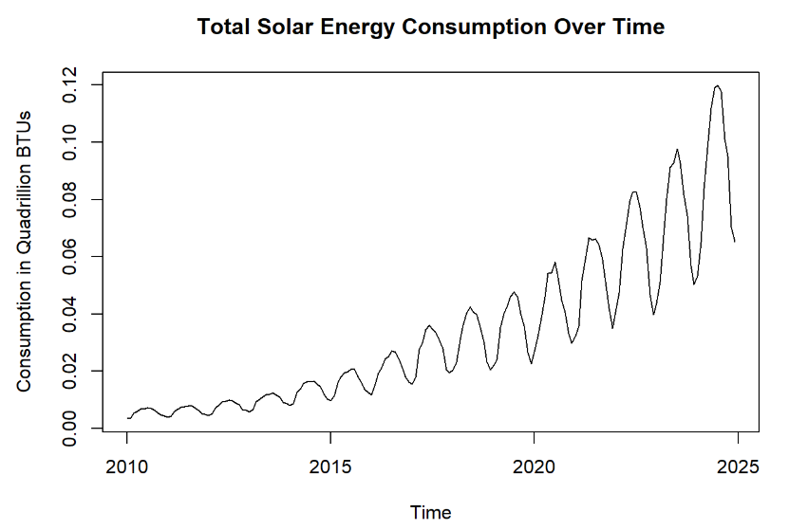
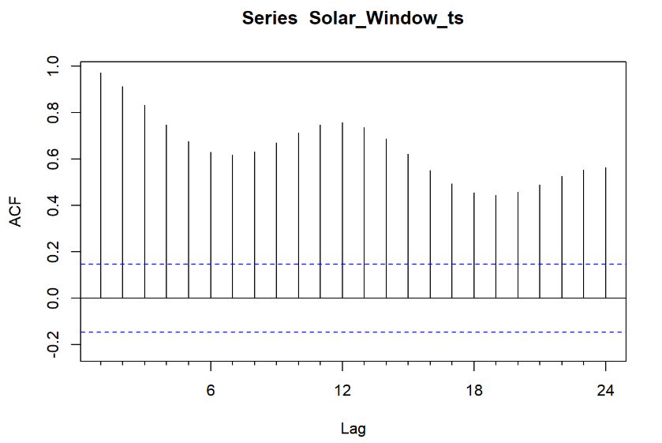
Exploration
Clear upward trend in solar energy consumption from 2010 on
Strong seasonal patterns – peaks during warmer/summer months (May, June, July), dips in winter
ACF plot shows significant autocorrelation – supports need for time series modeling
Upticks at lags 12 and 24 – seasonality

Slide 6
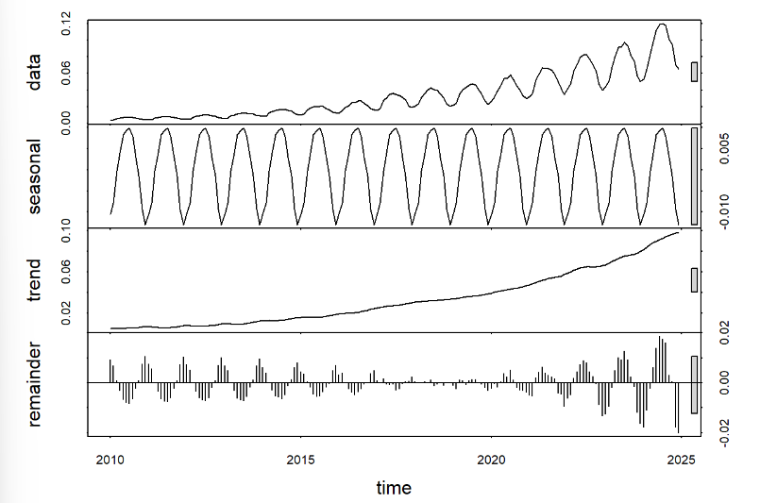
Exploration (Decomposition)
Trend Component
~0 to 0.10: most of the change in the data comes from the steady upward trend (solar adoption increasing)
Seasonal Component
Seasonality accounts for ±0.01 units: small but meaningful relative to the overall data range, about 8-10% of total signal
Remainder (residuals)
Approximately ±0.02
Higher variability from 2010-2015, despite low data values
Caused by relative impact: even small noise appears large when data is near 0
Smaller remainder fluctuations from 2015-2020 (better modeled by trend and seasonality)
Increased noise again after 2020: possibly due to external shocks, structural changes

Slide 7
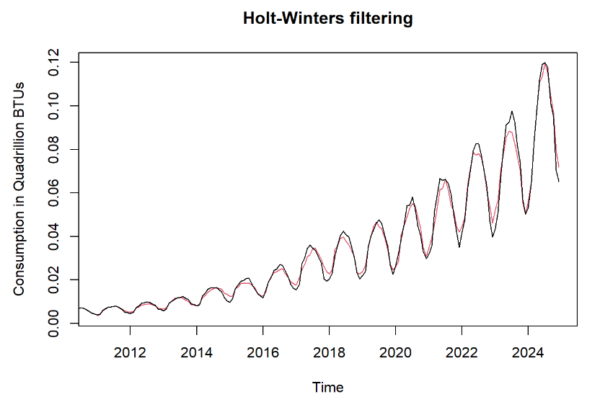
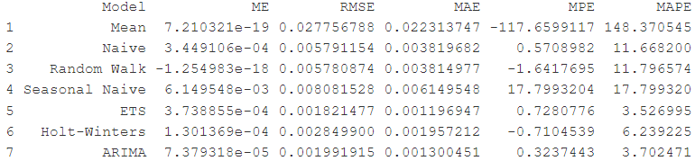
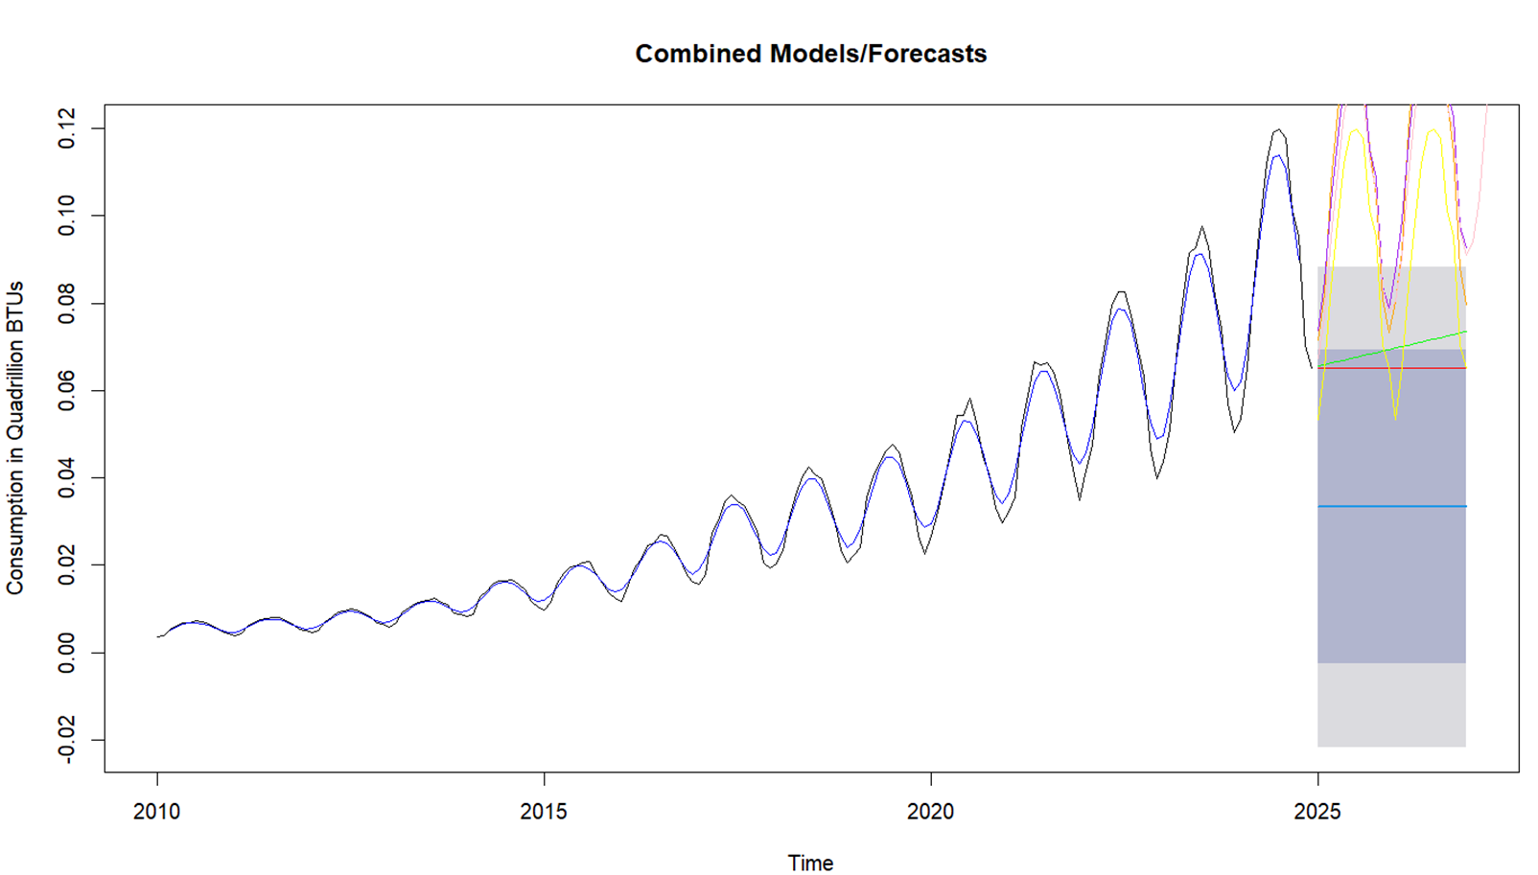
Judgement
Mean and Naïve: do not capture trend & seasonality well
Seasonal Naïve: captures seasonality but not trend
Random Walk: captures trend but not seasonality
Holt-Winters
Forecast closely follows the original series, with only small deviations
ACF partially clean, some autocorrelation
Alpha value very low (~0.0886) - less responsive to sudden level changes
MAPE: ~6.24%

Slide 8
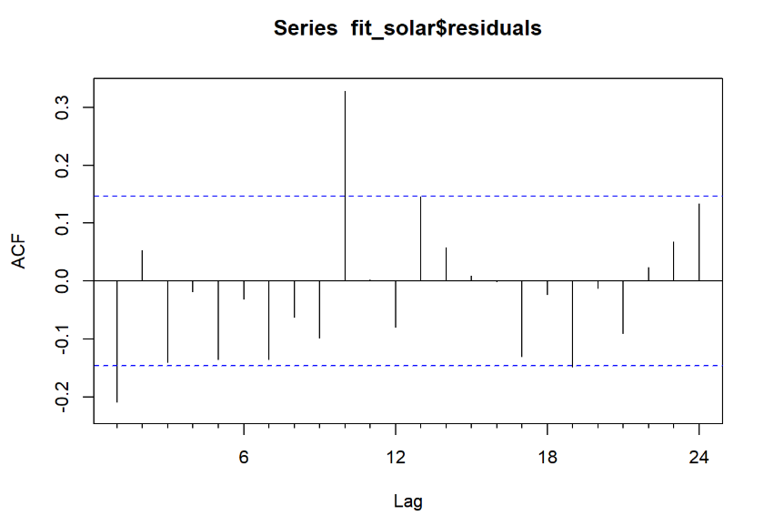
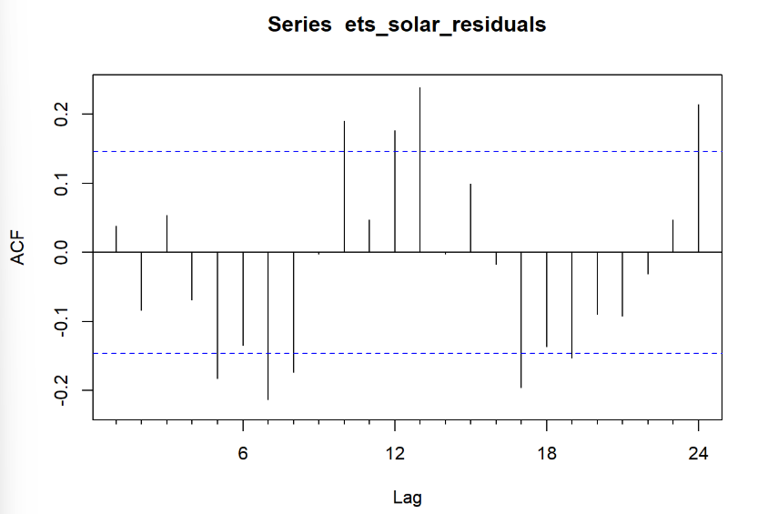
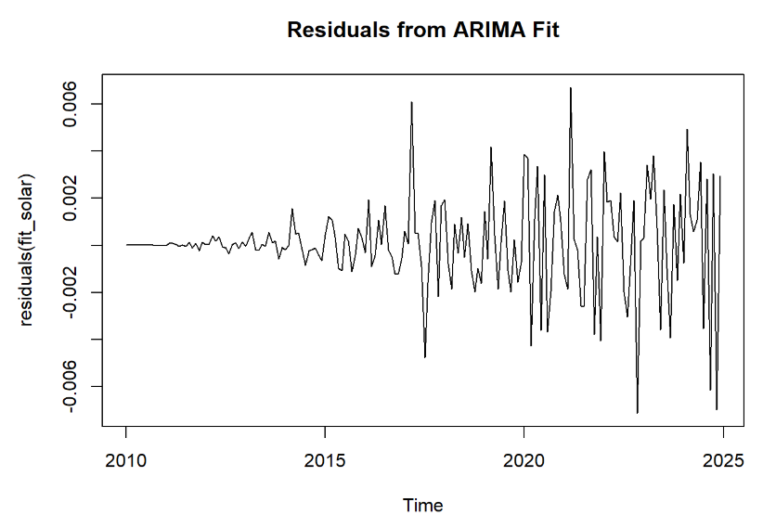
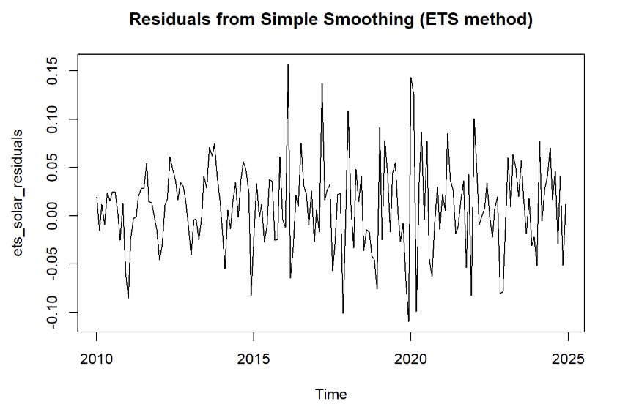
Judgement
ETS (error, trend, seasonality)
ACF plot shows more autocorrelation than ARIMA, some seasonal structure remains in the residuals
Alpha is 0.6418: moderately responsive to recent level changes
Beta is 0.04: slow to adjust to sharp increases in trend
Gamma is 0.18: assumes stable seasonality, underestimates any sharp seasonal increases
Residuals are wider (up to ~0.15)
Lowest MAPE (~3.53%) - likely better at short-term forecast accuracy
ARIMA(2,1,2)(0,1,1)
Residuals show minimal autocorrelation – most resemble noise
ACF: cleanest of the models, only two significant lags
Slightly higher MAPE than ETS (~3.70%)

Slide 9
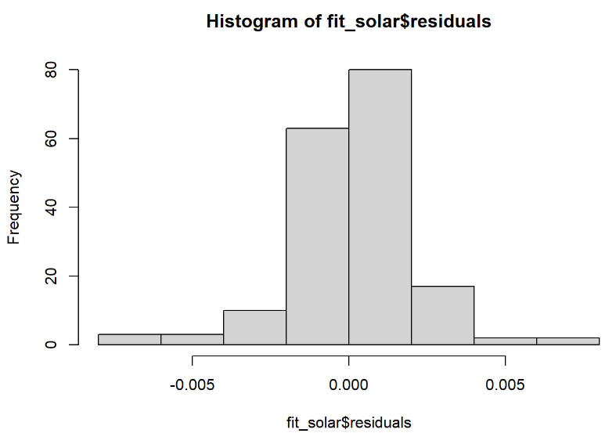
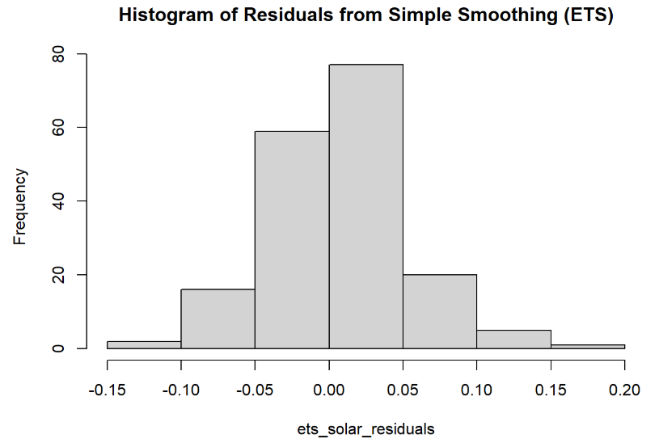

Slide 10
Recommendation
Model | MAPE (forecast is off by ___%) | Residual Diagnostics (pass/fail) | June 2025 Forecast (quadrillion BTUs)
Mean | 148.3705% | Fail | 0.0332866
Naïve | 11.6682% | Fail | 0.065224
Random Walk | 11.7966% | Fail | 0.06729346
Seasonal Naïve | 17.7993% | Fail | 0.119023
Holt-Winters | 6.2392% | Partial pass | 0.13599133
ETS | 3.5270% | Partial pass | 0.13852133
ARIMA | 3.7025% | Pass | 0.12910398
Selected models: ETS or ARIMA
ETS has best MAPE (forecast only off by ~3.53%), better for short-term forecasting with stable seasonal patterns
ARIMA (2,1,2)(0,1,1) has best residual diagnostics and high accuracy (forecast only off by ~3.70%)

Slide 11
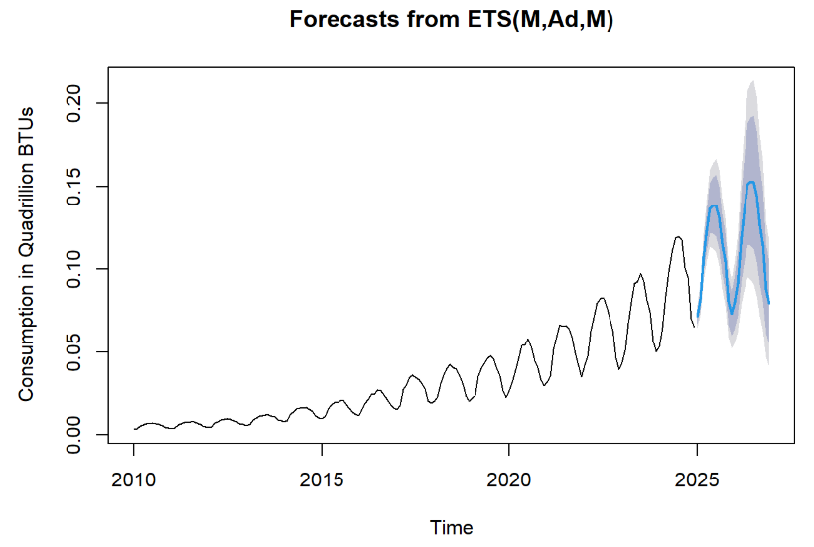
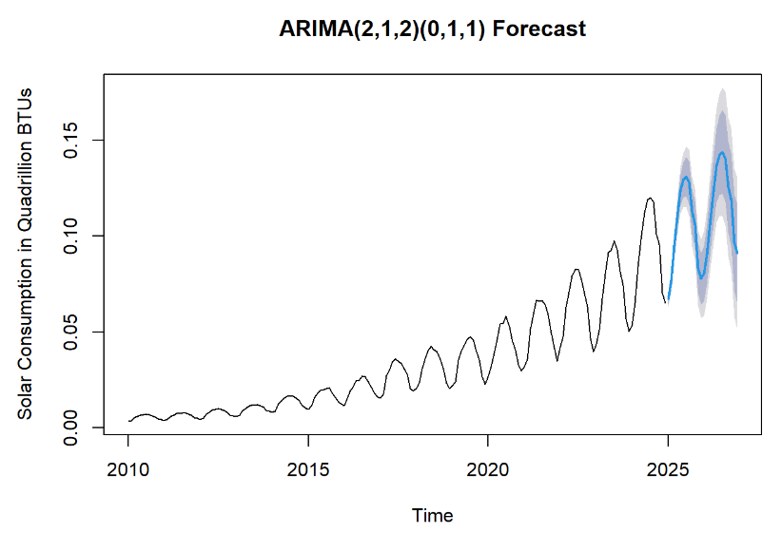
Forecast and Conclusion
Forecast horizon: 2 years (24 months)
Continued upward trend expected with seasonal peaks in summer
ETS → 0.13852133 quadrillion BTUs in June 2025
ARIMA → 0.12910398 quadrillion BTUs in June 2025
Implications:
Supports long-term solar infrastructure investment
National energy security and independence timeline

